Slide 1
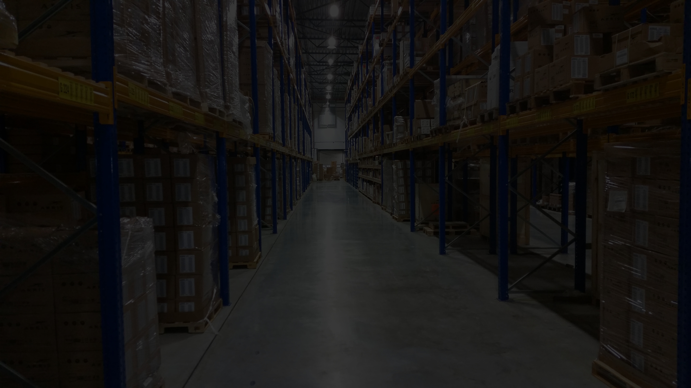


Restaurant Management System

Slide 2


Project Idea
A full-stack solution built using .NET MVC, Entity Framework (EF), and a SQL Server database to manage restaurant operations.
Key Features
Order Management
Reservation Management
Inventory Management
Employee Management
ustomers can place orders, track their status, and process payments.
Enables customers to reserve tables, and administrators to manage bookings.
Automatically update inventory with orders, track stock, and alert when items run low.
Manage employee shifts, roles, and performance.
Billing & Payments
Frontend Interface
Process customer payments securely, generate invoices, and track transactions.
Responsive user interface to ensure an optimal user experience on both desktop and mobile devices.

Slide 3
Project Objectives
Develop a Full-Stack Application
Real-time Data Management
Create both backend and frontend functionalities using .NET MVC and Entity Framework.
Ensure that restaurant data (orders, inventory, reservations) is updated in real time.
Maintainable and Scalable
User-friendly Frontend
Build a modular system based on MVC architecture, ensuring easy future enhancements and scalability
Provide a responsive, intuitive UI for customers, staff, and admins.

Slide 4
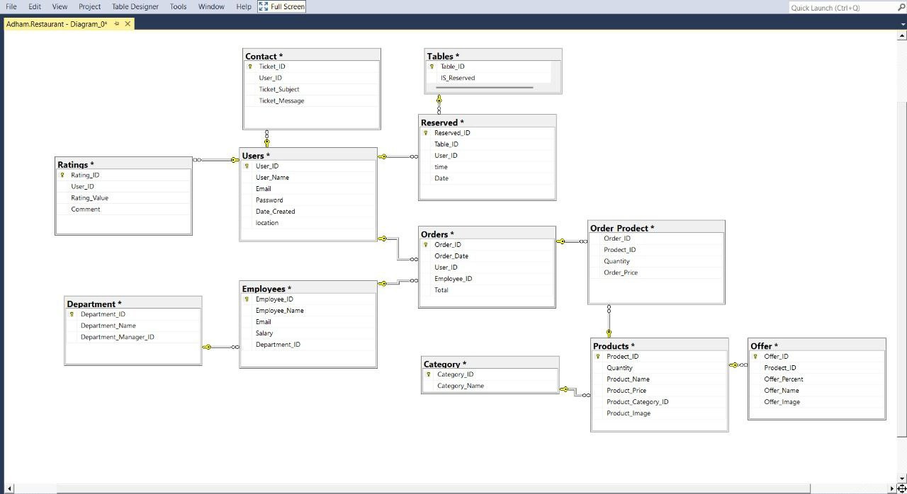
ERD

Slide 5
Requirements
Functional Requirements:
Login
Register
Forget password
Take order delivery
View menu
Know locations
Know Discounts
Give feedback
Ask for information
Non-functional Requirements:
Design a user-friendly website
web open 24/7
Protect the database (security)
Make the web more efficient

Slide 6
Requirements
Backend Development:
.NET Framework
Framework (EF)
SQL Server
LINQ
.NET MVC
Frontend Development:
HTML5
CSS3
JavaScript (jQuery)
Bootstrap
Tools:
Visual Studio Community: IDE
Git / GitHub
Visual Studio Code
SSMS
Trello

Slide 7
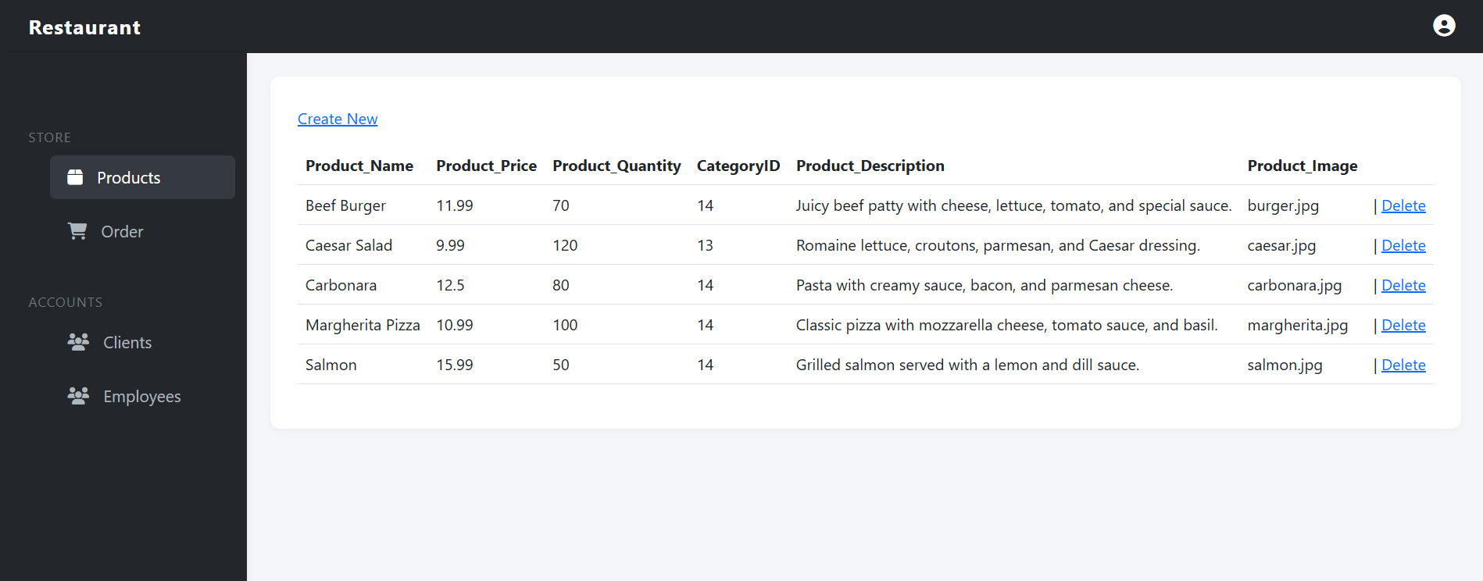
Documentation (Admin View)
Products:

Slide 8
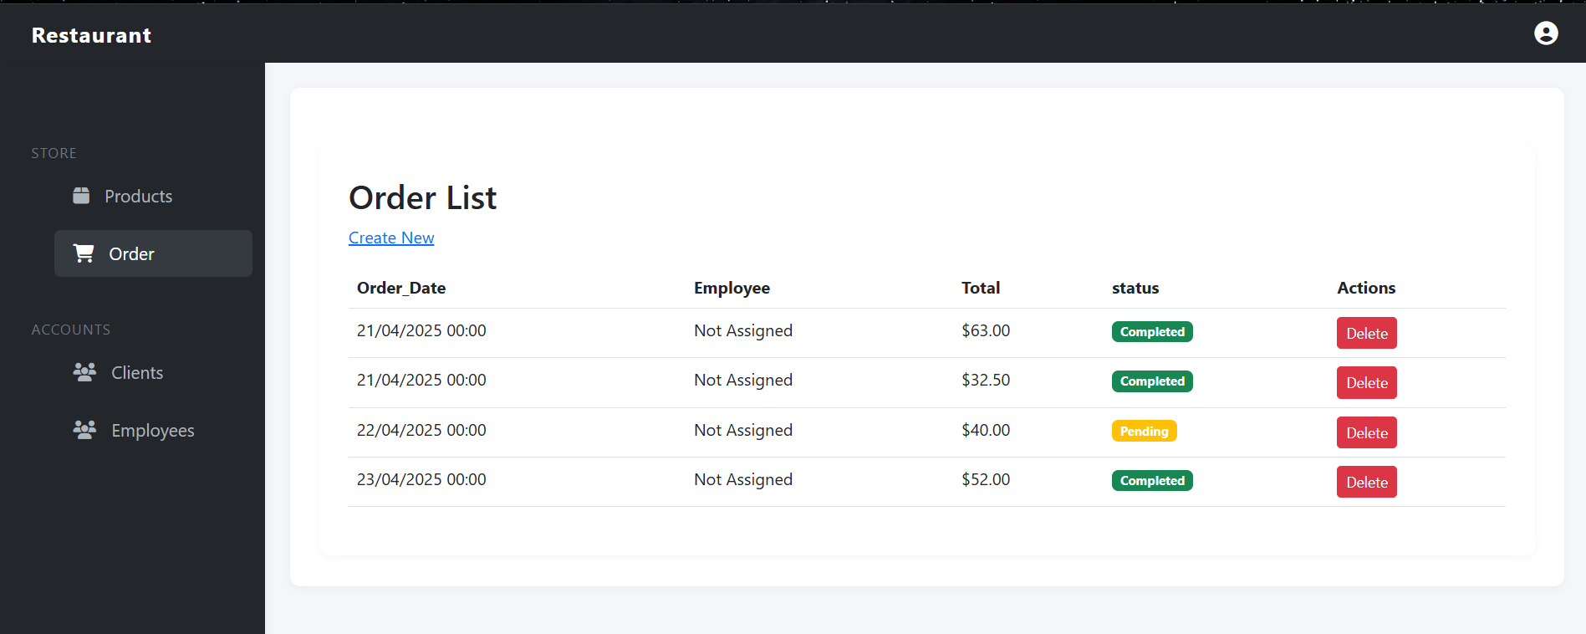
Documentation (Admin View)
orders:

Slide 9
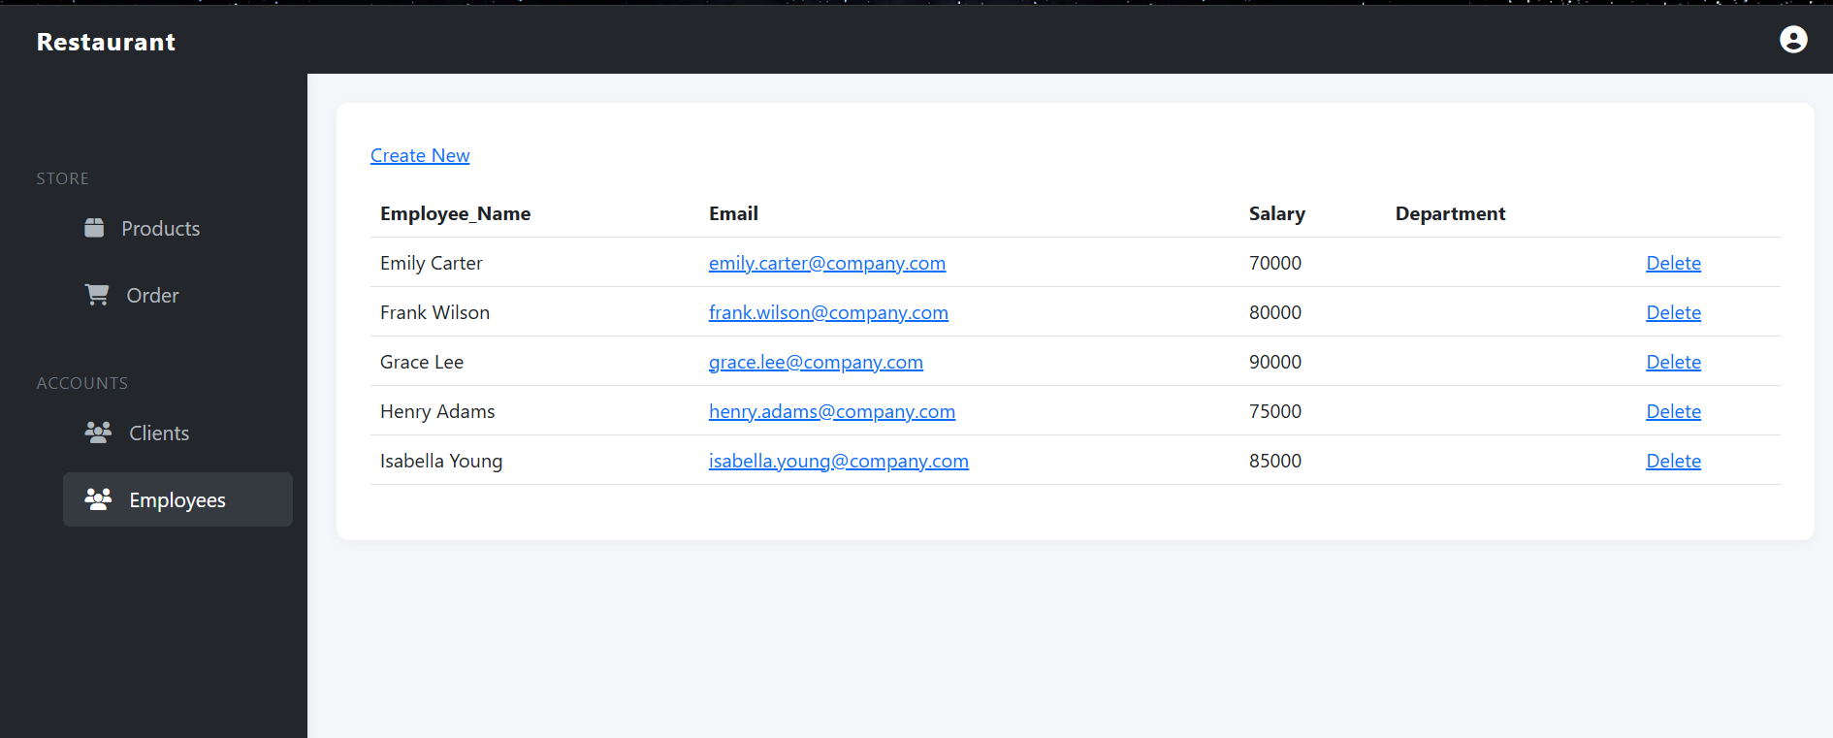
Documentation (Admin View)
Accounts:

Slide 10
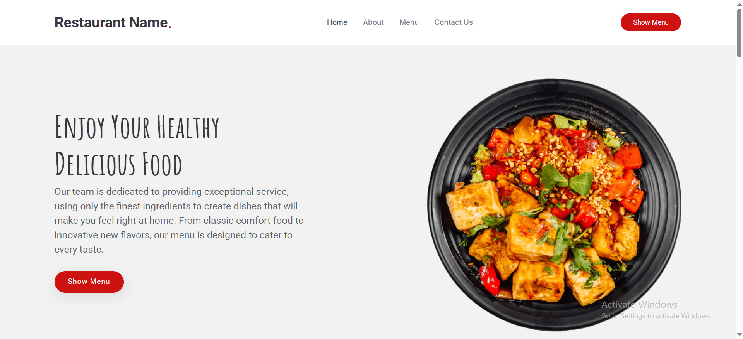
Documentation (Home View)

Slide 11
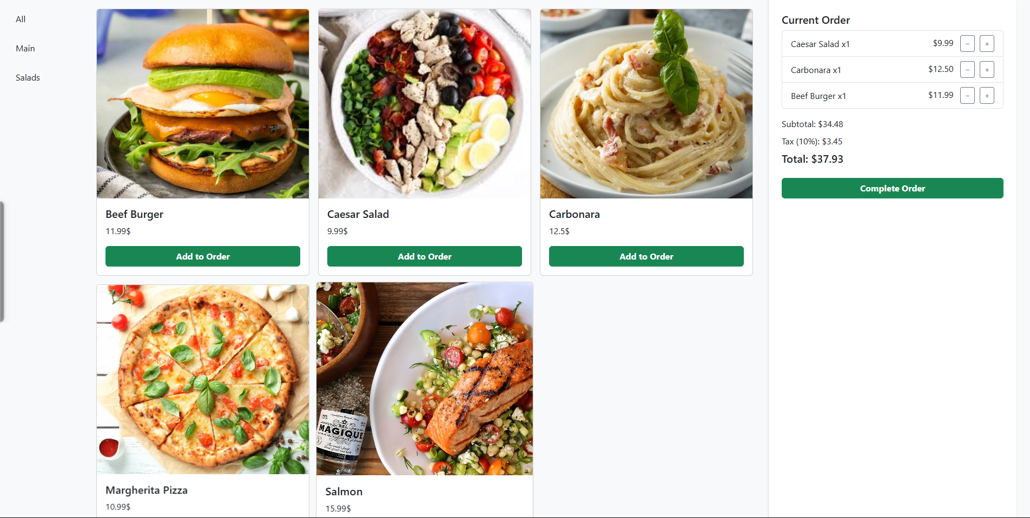
Documentation (Cashier View)

Slide 12
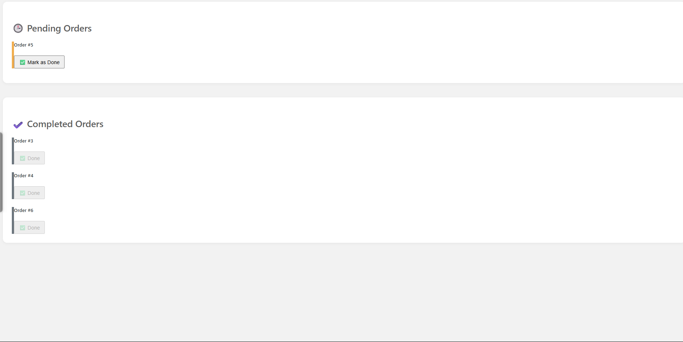
Documentation (Kitchen View)

Slide 13
Innovation
Real-time Data Handling: Orders, inventory, and reservations are updated in real-time across the system, ensuring all users see current information.
Advanced Analytics: Backend support for generating reports on customer orders, inventory levels, and sales trends.
Seamless Payment Integration: Integration with popular payment systems (e.g., Stripe, PayPal) for secure online payments and invoicing.
Mobile Compatibility: The system is designed to be mobile-friendly, offering the possibility to extend it for mobile apps.
AI-based Ordering Predictions (Future): Predict popular menu items based on customer preferences and historical data, helping optimize inventory.
Scalable Architecture: The system is designed to handle peak traffic times and support future growth (more restaurants, online delivery integration).

Slide 14
Thanks
prepared by: Adham Elhwary
Ahmed Yousef
Muhammad Fouad Yousef Hosny Dolagy George

